Slide 1
Booch Methodology

Slide 2
The Booch method is one well-known OO-method
Design the systems using the object paradigm
Covers the analysis and design phases of an OO-system implementation
Booch defines a lot of symbols to document almost every design decision

Slide 3
This method starts with class and object diagrams (a discovering activity) in the analysis phase
These diagrams to be refines through various steps
Refinement process continuous till the problem domain gets more and more understood following an evolutionary approach

Slide 4
Design symbols are to be added when ready to generate code
Usually it represents very final implementation decisions
Booch notation are larger sets and appears to prove beneficial: it is possible to fully document the OO-code

Slide 5
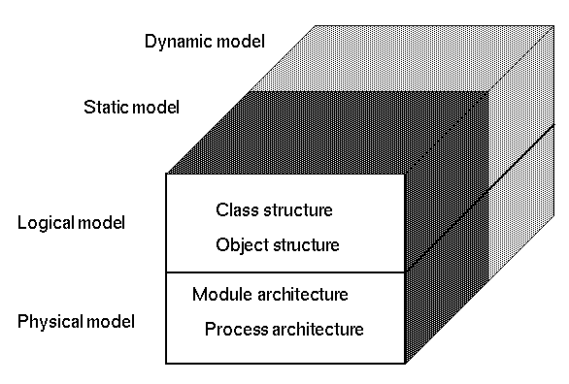
Overview

Slide 6
Booch proposes different views to describe an OO system
Physical model
Logical model
Static model
Dynamic model

Slide 7
1.Physical model
It describes the concrete hardware with respect to the software components of a system.
Module and process architecture
Processors
Devices and communication connections between
them

Slide 8
2.Logical model (i.e., the problem domain) :
Represented in the class and object structure
In the class diagram one builds up the architecture, or the static model
To deal with complex diagrams
the notation allows class categories to group classes into namespaces, each category being itself a class diagram.

Slide 9
3 Static Model:
class diagrams (and the relationships therein) are mostly static
4 Dynamic Model :
Object diagrams (and the relationships therein) describe the dynamic behavior of the system
In this instance relationship means message exchanges between objects

Slide 10
It consists of the following Six diagrams:
Class diagrams
Object diagrams
State transition diagrams
Module diagrams
Process diagrams
Interaction diagrams

Slide 11
Class Diagrams
Class:
The modular unit of OO software decomposition
As a type, a class represents a set of similar run-time
data elements, or objects
Share a common structure and a common behavior
As a decomposition unit
a class is a group of related services packed together under a single representative name

Slide 12
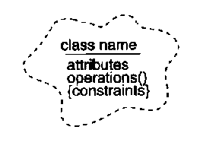
Notations for Class

Slide 13
class Class Name { public: // constructors // destructors // operators // modifiers // selectors protected: // member objects private: // friends };

Slide 14
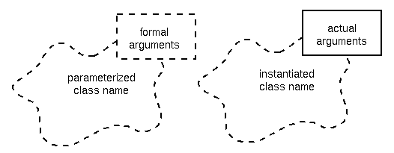
Parameterized class:

Slide 15
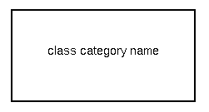
Class category:
A logical collection of classes
Some of which are visible to other class categories, and others are hidden
The classes in a class category collaborate to provide a set of services.

Slide 16
Class categories allow us to represent an important architectural element of the system to be implemented:
Clusters of classes that are cohesive
But loosely coupled relative to other class aggregates
Categories are a way to partition the logical model of a system
They represent an encapsulated name space

Slide 17
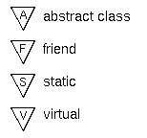
Class adornment and Properties (for relationships)

Slide 18
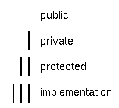
Export control (for attributes/operations and relationships):

Slide 19
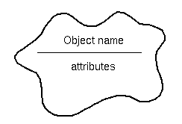
Object Diagram
Object
Object link
Synchronization
Visibility

Slide 20
State Transition Diagram
Shows the dynamic behavior of classes
Module Diagram
Module diagrams are used to show the allocation of classes and objects to modules in the physical design of a system
Process Diagram
A process diagram is used to show the allocation of processes to processors in a physical design of a system
Interaction Diagram
Interaction diagrams trace the execution of a scenario in the same context as an object diagram

Slide 21
Two processes:
BOOCH Methodology prescribes 2 different process
1. Macro Development Process
2. Micro Development Process

Slide 22
1.Macro development process
Primary concern – technical management of the system
Steps involved:
Conceptualization.
Establish the core requirements and develop a prototype
Analysis and development of the model
Use the class diagram to describe the roles
Responsibilities of objects
Use the object diagram to describe the desired behavior
of the system

Slide 23
Design or create the system architecture
Use the class diagram to decide what classes exist and how they relate to each other
The object diagram to decide what mechanisms are used
The module diagram to map out where each class and object should be declared
The process diagram to determine to which processor to allocate a process.
Evolution or implementation
Refine the system through much iteration
Maintenance
Make localized changes to the system to add new requirements and eliminate bugs

Slide 24
2.Micro development process
The micro development process is a description of the day-to-day activities.
Steps involved:
Identify classes and objects
Identify classes and object semantics
Identify classes and object relationships
Identify classes and object interfaces and implementation

Slide 26
An alarm state transition diagram with Booch notation

Slide 27
Reference:
Ali Behrami, “Object Oriented Systems Development using Unified Modeling Language “,McGraw Hill International Edition.
Grady Booch, “Object Oriented Analysis and Design with Applications”, Addison-Wesly.
https://www.slac.stanford.edu/BFROOT/www/doc/workbook_kiwi/coding/booch/method.html

